Slide 1
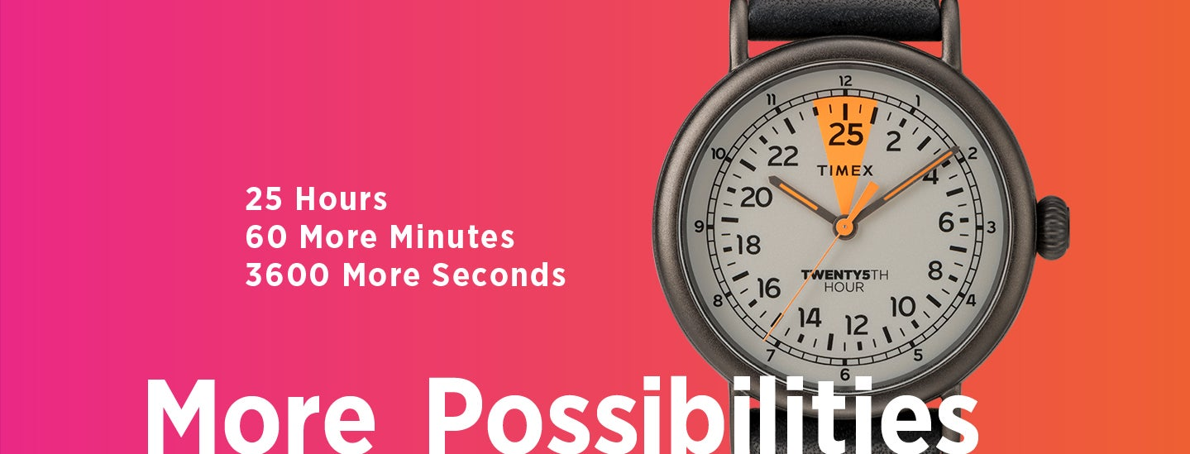
The 25th Hour
I.C.E. TMC 501st Meeting
TTM-Mark
Sat., 19:30-21:30, 2020/07/25
Notes:
TTM的问题多样化一点儿，五花八门的内容都可以想，脑洞大一点儿，最好维度更广一点，不要只想一个方面。TT的形式越多样，大家的参与度就会越高，而且要让参与者有出其不意的感觉。
维度：
时间管理

Slide 2
1
2
3
4
5
6
7
8

Slide 3
1. How do you arrange your time and make it valuable? Just like you have 25 hours a day.
Return

Slide 4
2. If you do have the 25th hour, how do you handle the difference with the others?
Return

Slide 5
3. Role Play
Tom is a doctor, he is too busy to take care of his family. His
wife, Alice, has a big conflict with him because Tom have
no time to be with her. Tom has no idea about this. At this
time, he meet a magician.
Role1: Tom
Role 2: Magician
Return

Slide 6
4. The 25th hour is a special hour. In this period, the time machine appears, you can take the time machine
to go back to the past. What would you want to do in
this time?
Return

Slide 7
5. If you do have the 25th hour, what will you use it to do something you’ve already want to do?
Return

Slide 8
6.What tools you use to improve you efficiency? What’s more, how do you do that?
Return

Slide 9
7.Do you think that go to bed early and get up early can make you effective? Why?
Return

Slide 10
8.For a fireman, what does the 25th hour mean for him?
Return

Slide 11
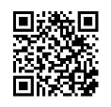
Thank you!

